Slide 1
Azure and AWS for Elastic Trainers
MCT Program Updates
Everything as Code

Slide 2
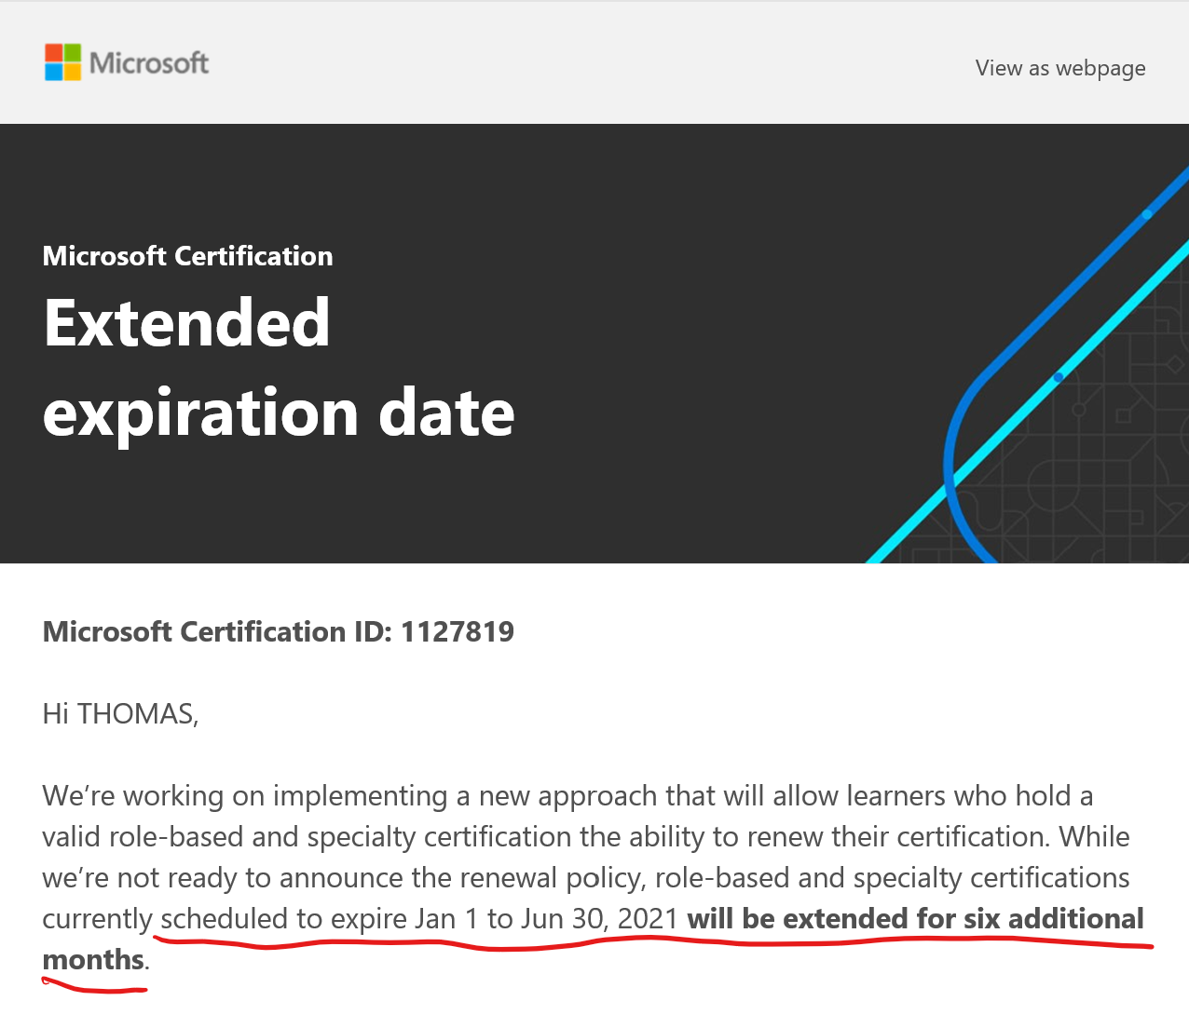

Slide 7
Stephanie Jasmin
MCT Program Lead
November 2020

